Slide 1
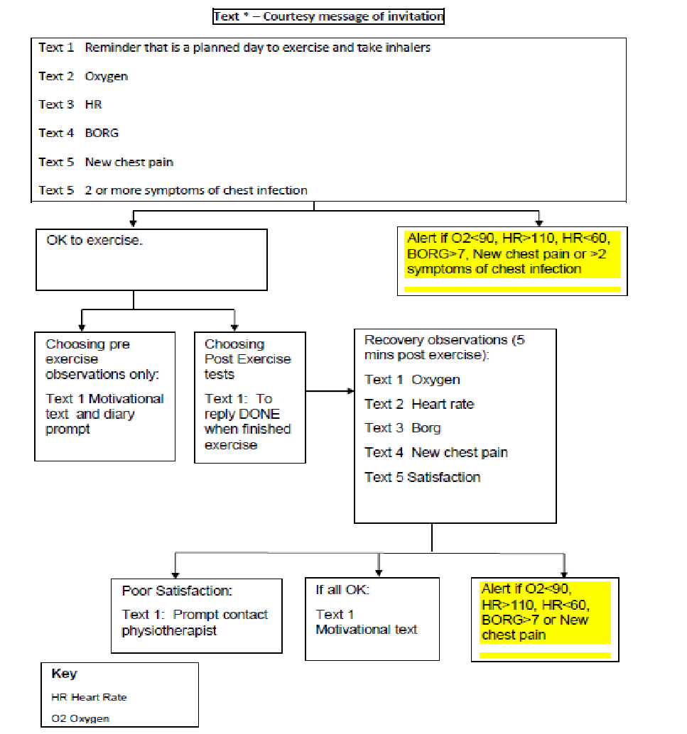
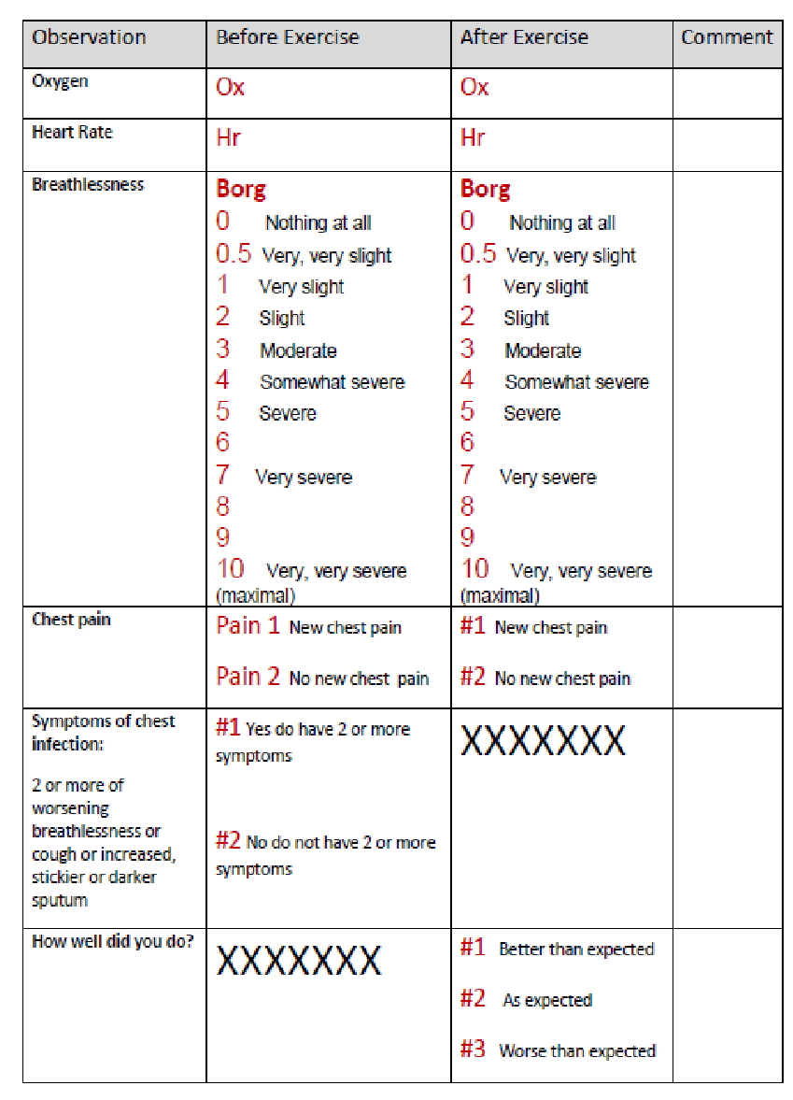
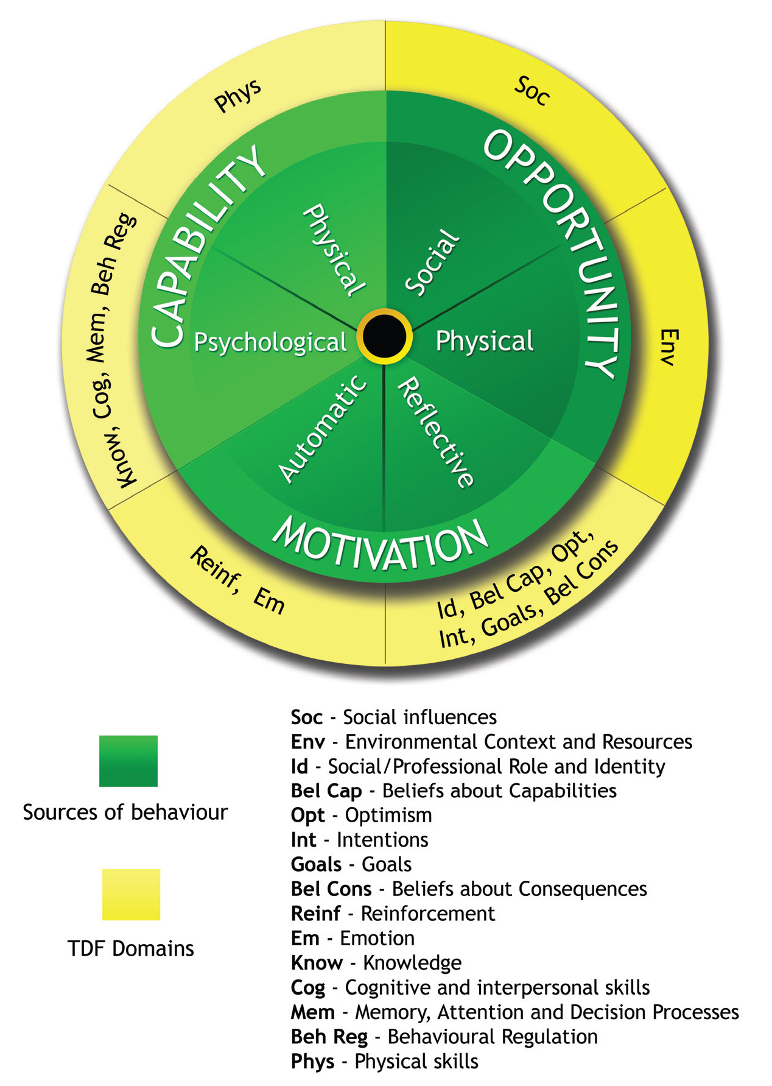
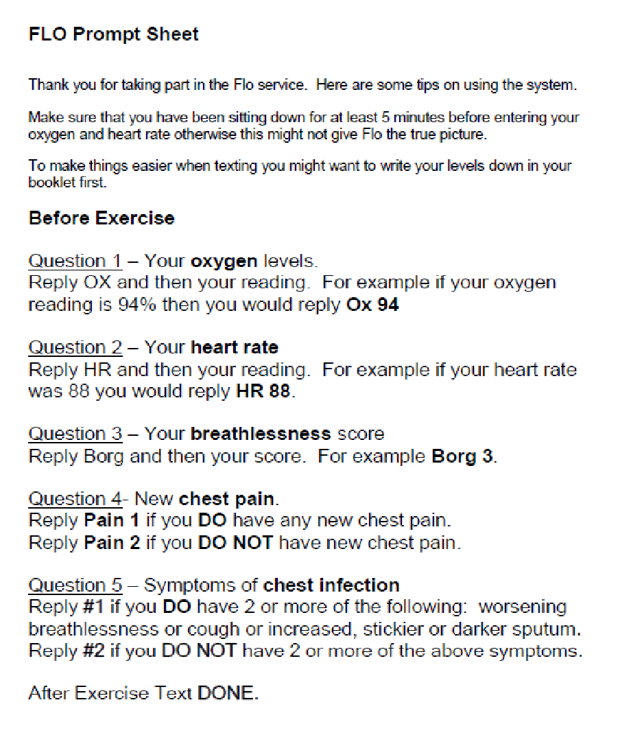
A pragmatic service evaluation of the implementation of the Florence (FLO) telehealth system in the early pulmonary rehabilitation (EPR) management of people with Chronic Obstructive Pulmonary Disease (COPD) following acute exacerbation.
Cath O’Connor, Jayne Stocks Sheffield Teaching Hospitals NHS Foundation Trust; Katie Biggs University of Sheffield; Karen Moore Simple Telehealth
Introduction: NICE guidelines recommend early PR for people following AECOPD. Potential problems highlighted have been associated with adherence and safety. FLO Simple Telehealth has the potential to address these problems.
Aim: To conduct a comprehensive pragmatic service evaluation assessing the feasibility of implementation of FLO telehealth within EPR following acute exacerbation of COPD (AECOPD).
Methods: Semi-structured interviews were conducted and the CRQ, GAD-7 and PHQ-9 questionnaires were administered prior to and following FLO telehealth to support EPR. Qualitative data analysis involved the use of the COM-B theoretical framework and NVivo Software.
Results: Six participants were interviewed at baseline. Three participants commenced and completed EPR and were interviewed at follow up. Interview data demonstrated that FLO was acceptable prior to and following EPR in a small number of participants. Questionnaire response was poor prohibiting triangulation of data.
Conclusions: FLO was found to be feasible in clinical practice and acceptable to service users. Strengths of the evaluation included the identification of factors to improve the implementation of FLO within EPR. Limitations were predominantly associated with small sample size and questionnaire response rate. Further evaluation of the clinical and cost effectiveness of FLO for supported EPR and self-management is warranted.
Reinforcement:
“It (FLO) makes me do it, because I know I have to send in the values following exercise.”
Emotion/ Reassurance:
“I would want to make sure that I’m at a certain level before I push myself a bit otherwise it could be dangerous couldn’t it”.
“I mean if it was coming in under 92 then that (FLO) would be doing its job, wouldn’t it because that would trigger alarm bells”.
Acceptability:
“Oh she’s lovely! I can’t wait for her ringing me up in a morning! (laughter)”.
“Yeah that’s good that. It encourages you a bit more doesn’t it”.
Theoretical Domains Framework linked to COM-B
For more information email: cath.o’connor@nhs.net

